Slide 1
Migrating from SCCS to Git:
Ravinder Maramamula
09/11/2025

Slide 2
Agenda
Introduction
Why Migrate from SCCS to Git?
Pre-Requisites for Migrating SCCS to Git
Migration Flow & RoadMap
Tools & Environment
Phase 1 – SCCS Backup
Phase 2 – Convert SCCS to RCS
Phase 3 – Convert RCS to CVS
Phase 4 – Convert CVS to Git Migration
Phase 5 – Post Migration
Benefits Realized
Q&A

Slide 3
Introduction
Purpose: Replace legacy SCCS with modern Git workflows
Scope: One-time migration + future readiness
Audience: DAS, Developers, Other ACE teams

Slide 4
Why Migrate from SCCS to Git?
SCCS is linear and file-based; Git is distributed and branchable
Git offers superior collaboration, CI/CD integration
SCCS is deprecated; Git is actively maintained and widely supported
Feature | SCCS | Git
Versioning | Linear, file-based | Branching, distributed
Collaboration | Difficult | Easy (cloning, merging)
Tooling Support | Minimal | Extensive (GitHub, GitLab, etc.)
Scalability | Limited | Highly scalable
Active Maintenance | Deprecated | Actively developed

Slide 5
Pre-Requisites for Migrating SCCS to Git
SCCS : We Have SCCS installed and working
Version we have: 5.08 (good, stable).
Needed to read original SCCS/s.* files and extract history.
Commands: sccs get, sccs prs.
RCS : We need to Install
Current: 5.9.x (modern, compatible).
Provides ci, co, rlog tools.
Used because RCS and SCCS have similar delta-based storage, and RCS is easier to bridge to CVS or Git
CVS : We need to install
Version: 1.11.x or 1.12.x (both are fine).
Provides cvs import, cvs log.
CVS can group multiple RCS files into a project repo, which aligns closer to Git’s project view.

Slide 6
Pre-Requisites for Migrating SCCS to Git ..
Git : We Have Git installed and working
we already have 2.43.5.
Final destination system.
Will need either:
git fast-import (for scripted imports), or
cvs2git (if using CVS path).
CVS2SVN : We need to Install cvs2svn / cvs2git tools
Usually packaged as cvs2svn.
Converts CVS repos to Git directly, preserving history and metadata.
Create an authors mapping file (recommended)
Example: authors.txt
jdoe = John Doe <jdoe@example.com>mjane = Mary Jane <mjane@example.com>
Used during migration so Git commits have proper author names/emails instead of cryptic SCCS user IDs.

Slide 7
Pre-Requisites for Migrating SCCS to Git ..
Backup everything
Archive SCCS repo : Store in a safe place before experimenting
tar -czf sccs_backup_$(date +%F).tar.gz /path/to/SCCS
Summary :
Step | Action | Why it matters
SCCS-RCS | Convert per-file SCCS deltas into RCS format | Makes history readable by CVS/Git tools
RCS-CVS | Import into CVS repo | Groups History across files, closer to git
CVS-Git | Run cvs2git | Preserves branches,authors,timestamps
Cleanup | Authors, Messages,Attributes | Makes History human-usable
Push | Publish Repo | Final Step to move to Github

Slide 8
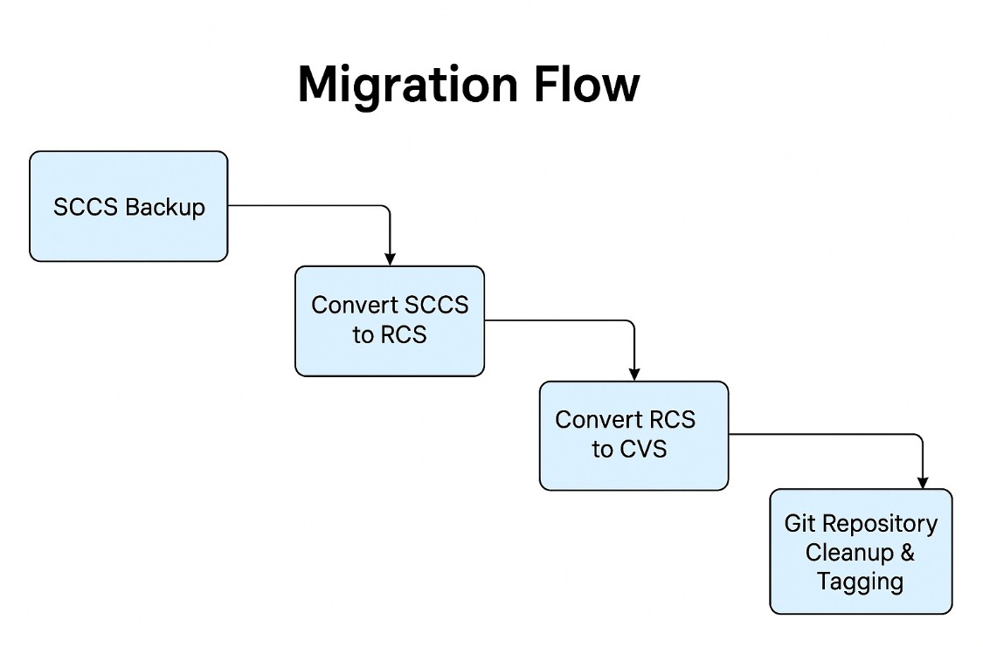
Migration Flow & RoadMap
Phase 1: SCCS Backup
Phase 2: Convert SCCS to RCS
Phase 3: Convert RCS to CVS
Phase 4: Convert CVS to Git
Phase 5: Git Repository Cleanup & Tagging

Slide 9
Tools & Environment
Tools: sccs, rcs, cvs, cvs2git/cvs-fast-export, shell scripts
Environment: Linux/macOS with development tools
Pre-reqs: Read access to SCCS, sufficient disk space

Slide 10
Phase 1 – SCCS Backup
Command: find . -name 's.*' -exec cp --parents {} /backup/sccs_repo/ \;
Note: Preserve full directory structure and validate integrity

Slide 11
Phase 2 – Convert SCCS to RCS
Use custom script or sccs2rcs.sh tool
Each s.* becomes *,v in RCS format
Ensure metadata is preserved
Tool: sccs2rcs (sometimes bundled) or scripts that replay SCCS deltas into RCS ,v files.
What it does:
Reads SCCS delta files (SCCS/s.file.c)
Writes equivalent RCS files (file.c,v)
Preserves revision numbers, dates, authors, comments.
Why: RCS is easier to work with since CVS and Git tools understand RCS format natively.

Slide 12
Phase 3 – Convert RCS to CVS
Command: mv *,v to CVSROOT/ and cvs import
Ensure commit history is preserved
Tool: cvs import
What it does:
Imports RCS-controlled files into a CVS repository.
Creates a project-level repo instead of independent file histories.
Groups changes so tools like cvs2git can produce better commits.
Why: CVS gives you multi-file commits (closer to Git’s model).

Slide 13
Phase 4 – CVS to Git Migration
Tool: cvs2git or cvs-fast-export
Command: cvs2git --blobfile=blob.dat --dumpfile=dump.dat
Result: Git repository with preserved history
Tool: cvs2git (part of cvs2svn)
What it does:
Converts CVS repository into a Git fast-import stream.
Preserves author, dates, log messages, and tags.
Handles branches and symbolic names better than a direct RCS import.
Why: Git can’t read CVS directly; cvs2git bridges the gap.

Slide 14
Phase 5 - Post-Migration Cleanup
Normalize authors using .mailmap
Tag versions if needed
Setup .gitignore, README, and archive legacy repositories

Slide 15
Benefits Realized
Centralized collaboration via GitHub/GitLab
Easier branching and merging
Modern CI/CD integration and improved traceability

Slide 16
Summary
The recommended process copies the entire SCCS directory tree first, preserving modification times and structure.
As you convert from SCCS to RCS and then to CVS, the project (folder/subfolder) structure remains consistent, since each version control format operates at the directory/file level and the conversion tools maintain this layout.
During the final step (CVS to Git, e.g., with cvs2git or git cvsimport), the directory hierarchy is imported into Git as-is. This means folders and their contents will appear as expected in the Git repository, matching the original layout.
Be aware that “empty” folders are generally not preserved in Git, since Git tracks files—not empty directories. If you need empty directories for build processes or other reasons, you must place a placeholder file like `.gitkeep` in them after migration.
In summary, with proper use of migration tools and by following the SCCS→RCS→CVS→Git process, your SCCS project’s folder structure will be preserved in Git. Empty directories, however, require special handling due to how Git works.

Slide 17
Q & A
Open floor for questions

